Slide 1
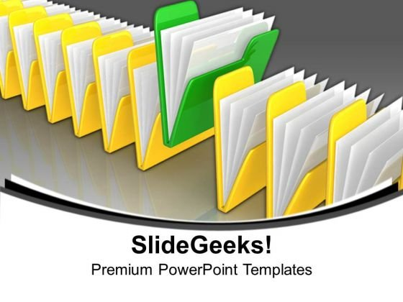

DATA
Data Cleaning
Sales
Customer
Products
Tools
Data Processing

Slide 2
